Slide 1

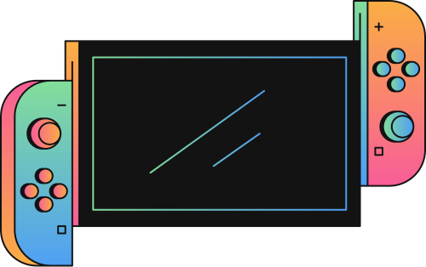
BRAINBRAWL: AI-POWERED QUIZ BATTLES FOR SMARTER LEARNING
START

Slide 2
WE TURN YOUR STUDY MATERIAL INTO AN AI-POWERED GAME WHERE LEARNING FEELS LIKE WINNING.

Slide 3
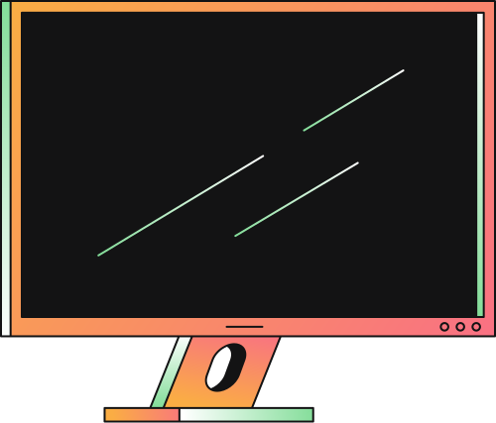

HOST
IRFAN

Slide 4


INTRODUCTION
"Brain Brawl" is an innovative EdTech platform that transforms traditional study methods into exciting, competitive learning experiences. This project leverages Artificial Intelligence to automatically generate multiple-choice questions (MCQs) from PDF notes and study materials, making revision smarter and more interactive. What sets Brain Brawl apart is its real-time quiz battle system, where users can challenge peers in live 1v1 or group quizzes, with a dynamic leaderboard tracking performance. By combining natural language processing (NLP), real-time web technologies, and gamified learning, Brain Brawl not only enhances student engagement but also personalizes the revision process — making it both effective and fun.

Slide 5

INSTRUCTION
WHY LEARNING FEELS LIKE A CHORE
60% OF STUDENTS SAY REVISION IS BORING AND UNPRODUCTIVE
QUIZZES ARE OFTEN GENERIC, NOT TAILORED TO THE LEARNER’S CONTENT.
MANUAL QUIZ CREATION IS TIME-CONSUMING.
EXISTING QUIZ PLATFORMS DON’T ALLOW PDF-BASED PERSONALIZED CONTENT.

Slide 6
YOUR NOTES → YOUR QUIZ BATTLES → INSTANT LEARNING
USERS UPLOAD PDFS OF NOTES OR TEXTBOOKS.
NLP models extract key content and generate intelligent MCQs.
Users enter 1v1 real-time quiz battles based on those questions.
Points are awarded for accuracy and speed.
A global leaderboard tracks performance and growth.

Slide 7


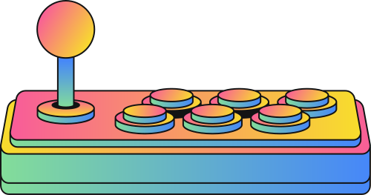
INSTRUCTION
HOW IT WORKS
PDF Upload
AI extracts topics and generates MCQs
Dynamic battle rooms created (topic-based)
Players join via link/code
Real-Time WebSocket Match
Analytics show strengths, weaknesses, and improvement areas

Slide 8

INSTRUCTION
KEY FEATURES
AI MCQ Generation from any PDF or document.
Multiple Battle Modes: 1v1, Group, Time-Limited Blitz, Solo.
Real-Time Leaderboards powered by WebSockets.
Personalized Learning with adaptive difficulty.
Offline + Sync Later for rural/low-connectivity use.
Post-Battle Analytics for performance insights.
Easy Multiplayer Joining via code, QR, or link

Slide 9
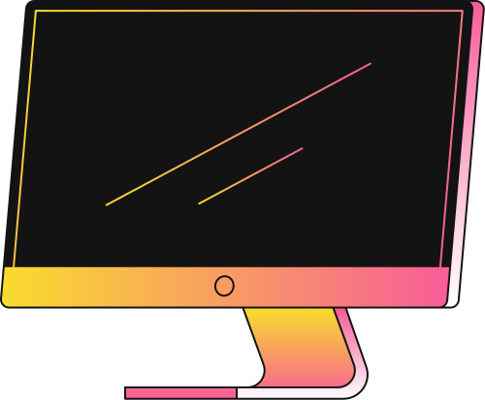
WHAT EXISTS (PARTIAL SIMILARITIES]
Kahoot!:
Real-time quiz battles, leaderboards, No AI question generation, no PDF parsing
Quizizz:
Multiplayer quiz system, Pre-made or manual questions only
Socratic by Google:
Extracts answers from images/PDFs using AI, No quiz battles, no gamified leaderboard
Google Classroom Add-ons:
Can generate MCQs and quizzes, No battle mode, no real-time interaction
ChatGPT plugins or apps:
Can generate questions from PDFs, No real-time battle mode or leaderboard
Toppr / Byju’s / Unacademy:
Provide quizzes and practice from content, No user-PDF based generation, no multiplayer battles

Slide 10
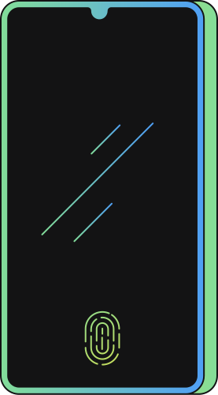
ARE YOU READY?
PLAY

Slide 11
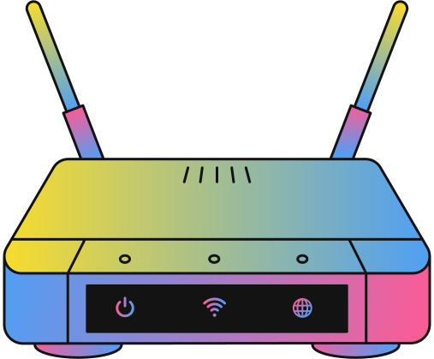
INSTRUCTION
WINNER
TEAM 1
SCORE: 9/10

